Slide 1
Fundamentals of Data Visualization
Ashwin Malshe, PhD

Slide 2
The Human Eye

Slide 3

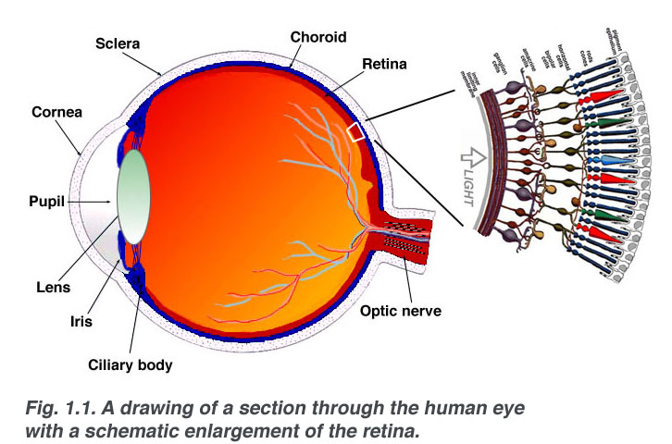

Slide 4
Cornea is responsible for 70%-80% of eye’s focusing power
Rest 20%-30% focusing ability comes from the lens
If objects are closer than the near point and farther than the far point, they cannot be brought to focus
If the far point is too close, it’s called “myopia”
If the near point is far, it’s called “presbyopia”

Slide 5

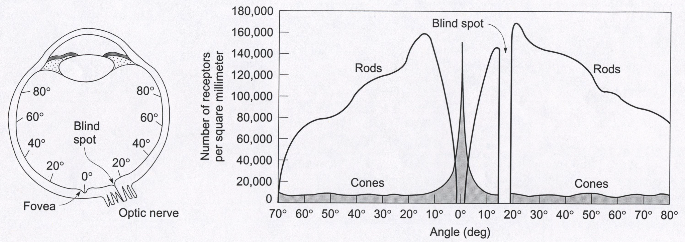

Slide 6
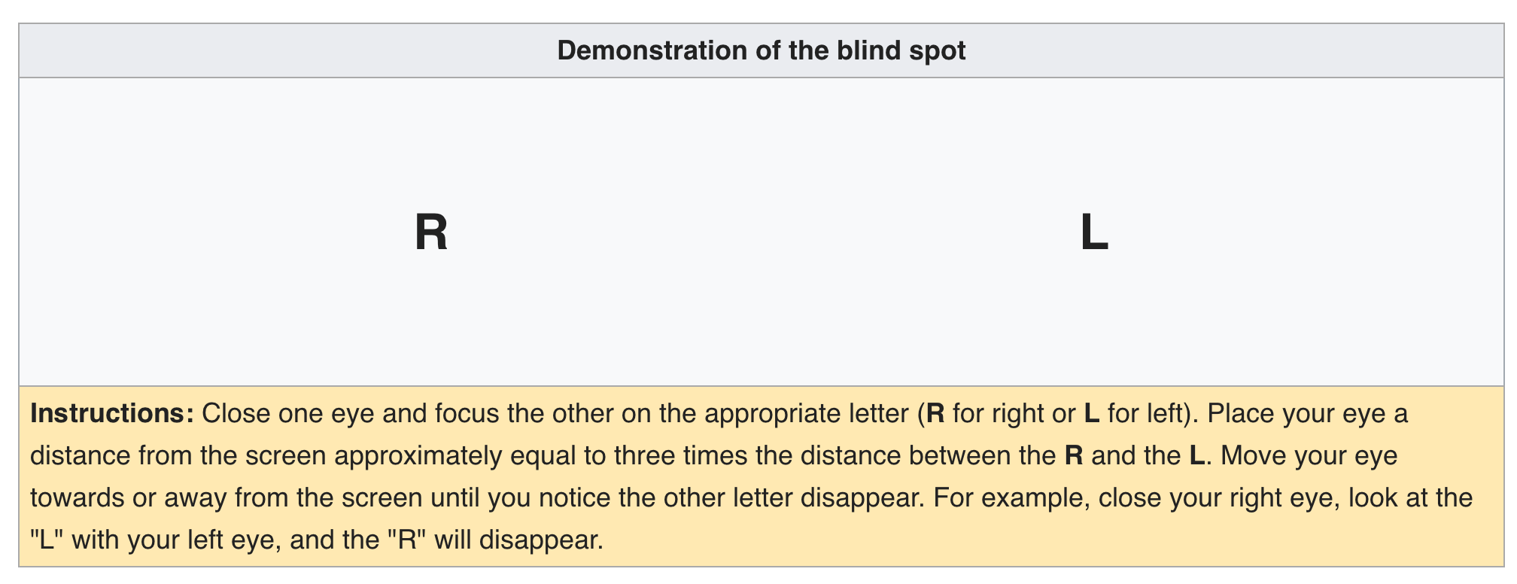
https://en.wikipedia.org/wiki/Blind_spot_(vision)

Slide 7

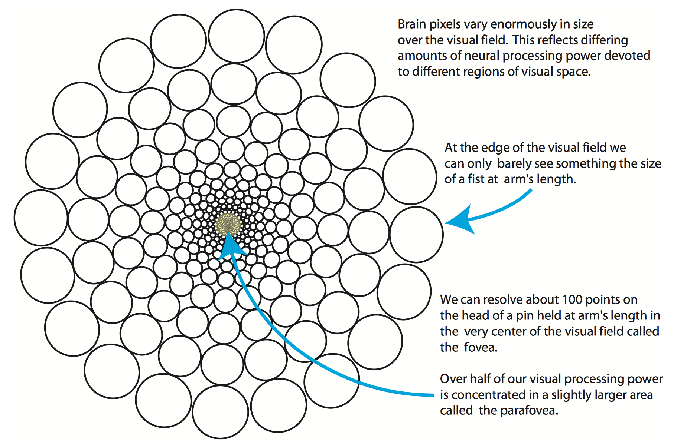
Fovea

Slide 8

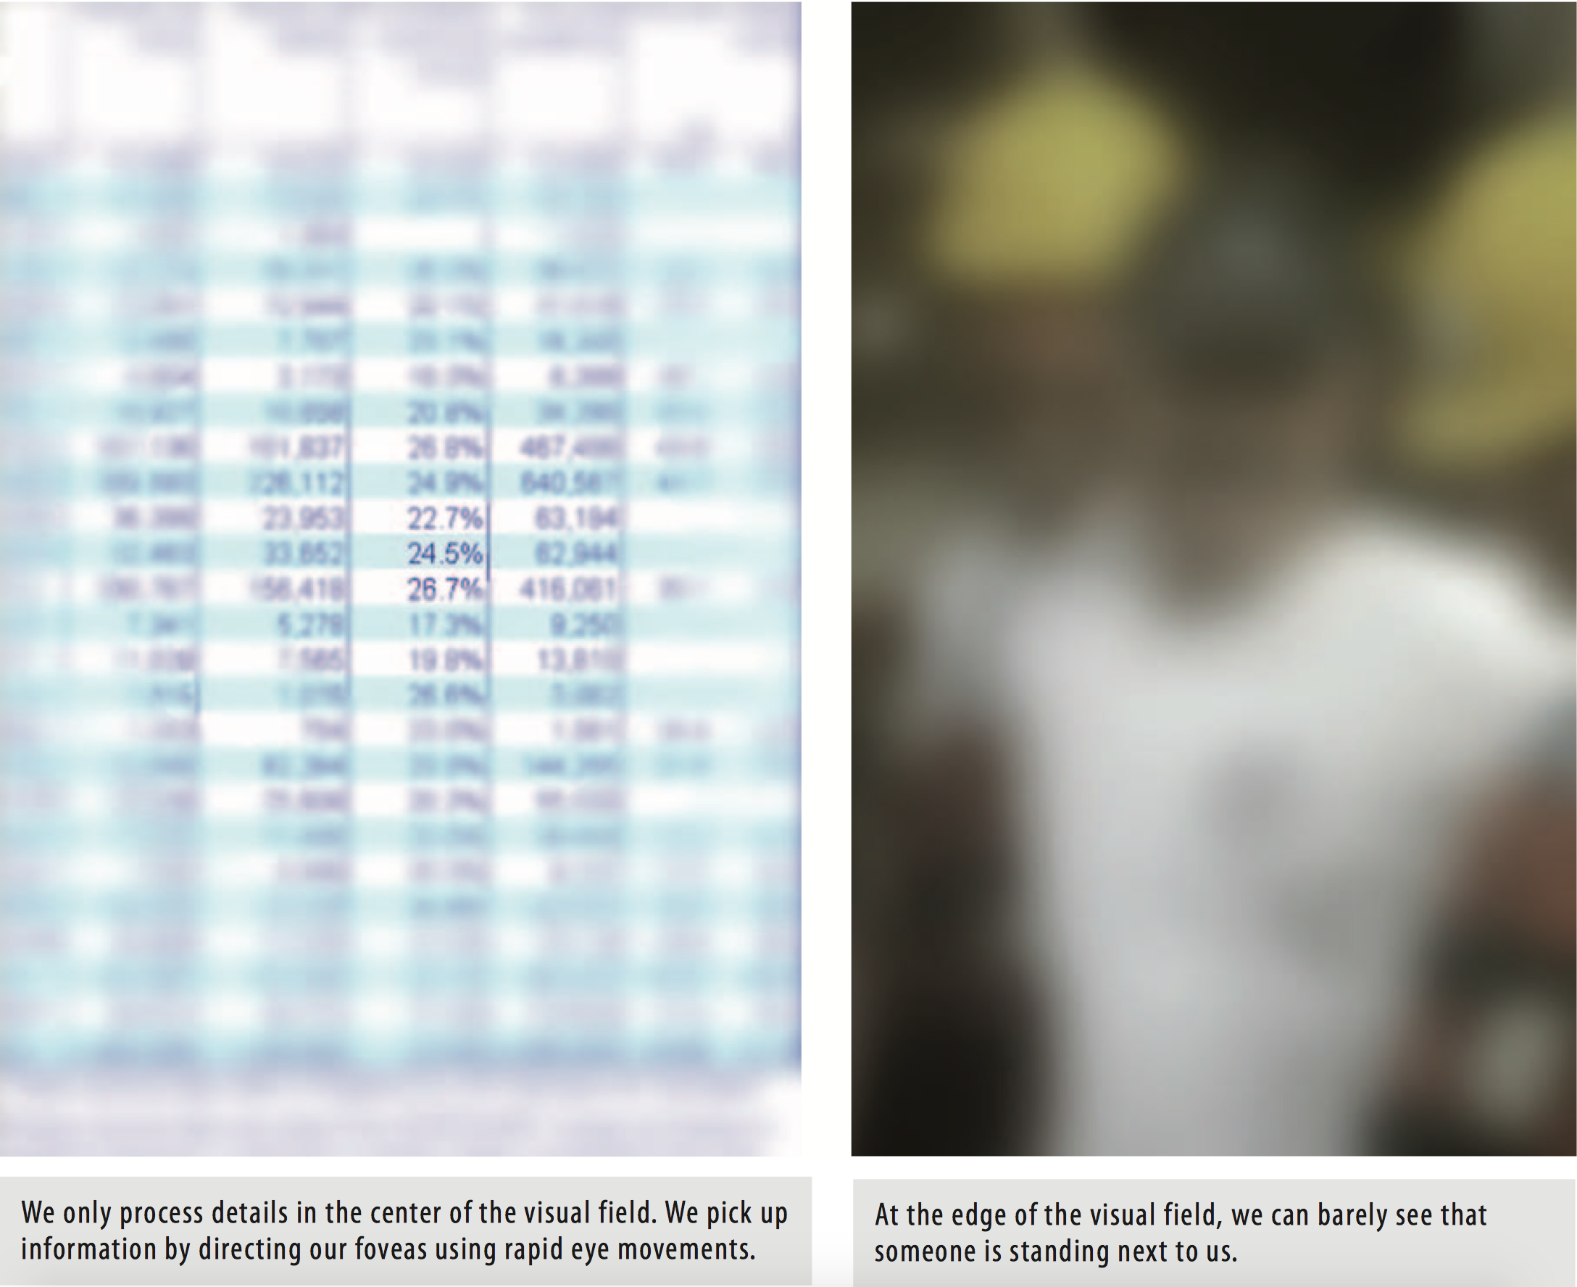

Slide 9
Examples Change Blindness

Slide 10

https://www.youtube.com/watch?v=FWSxSQsspiQ

Slide 11

https://www.youtube.com/watch?v=6JONMYxaZ_s

Slide 12
Example
Inattentional Blindness

Slide 13

https://www.youtube.com/watch?v=vJG698U2Mvo

Slide 14
Did you see the gorilla? Yes
No

Slide 15
Floating trash bins illusion!

Slide 16
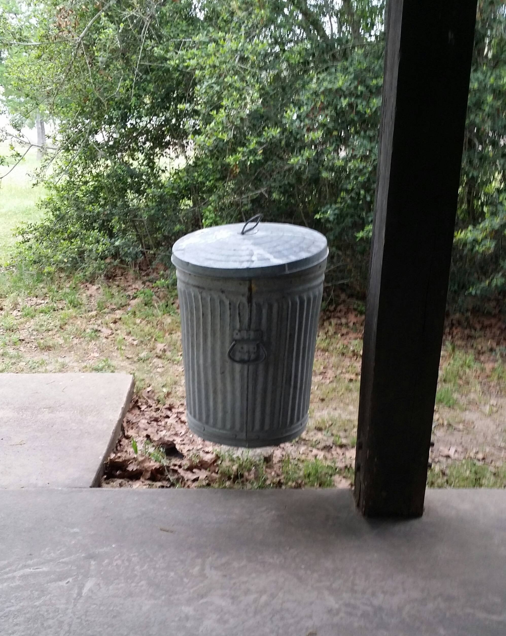


Slide 17
https://youtu.be/9Il_D3Xt9W0
Seeing the world as it isn’t
Daniel Simons

Slide 18
The End!

